Slide 1

Employee Data Analysis using Excel
STUDENT NAME : S.SUBITHA
REGISTER NO : 312216401
DEPARTMENT : B.COM(COMPUTER APPLICATION)
COLLEGE : SHRI SHANKARALA SUNDARBAI SHASUN JAIN COLLEGE

Slide 2

PROJECT TITLE
Employee Performance Analysis using Excel

Slide 3

AGENDA
Problem Statement
Project Overview
End Users
Our Solution and Proposition
Dataset Description
Modelling Approach
Results and Discussion
Conclusion

Slide 4

PROBLEM STATEMENT
A problem statement addresses issues in a timely and efficient manner. They help professionals break down complex situations into tangible goals that they can then communicate throughout an organisation. In every workplace, problems are inevitable.
Crafting an effective problem statement involves clearly defining the problem, explaining its relevance, supporting claims with data, proposing practical solutions, and demonstrating the benefits of these solutions.
This Photo by Unknown Author is licensed under CC BY-NC
Problem statements serve as important communication tools, providing insights about potential threats, fostering innovation and promoting technological development.

Slide 5
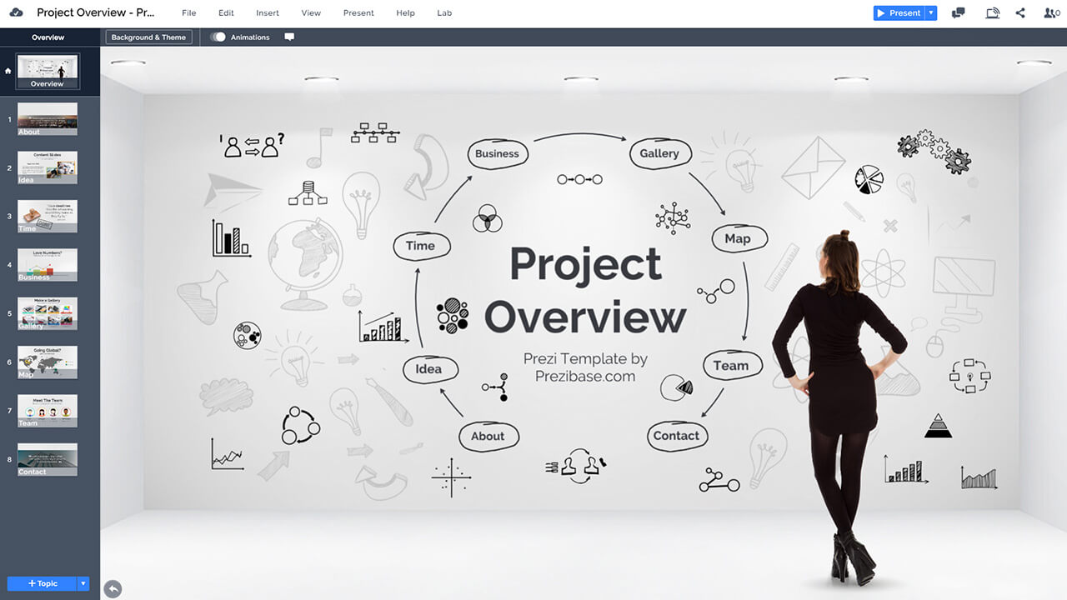
PROJECT OVERVIEW
The primary objective of this project is to analyze employee data to provide actionable insights into employee distribution, performance, compensation, and tenure. The analysis aims to support decision-making processes related to resource allocation, promotions, salary adjustments, and overall workforce management.
Employee Distribution: Assess the number of employees per department.
Compensation Analysis: Analyze salary data to determine average compensation, salary ranges, and disparities across departments.
Performance Analysis: Evaluate employee performance ratings and identify trends.

Slide 6

WHO ARE THE END USERS
Human Resources (HR) Team
HR Managers: Use the data to make informed decisions about hiring, promotions, and compensation adjustments.
HR Analysts: Analyze data for trends in employee performance, turnover, and other HR metrics.
Recruiters: Assess hiring trends and departmental needs to optimize recruitment strategies.
Training and Development Coordinators: Identify areas where additional training or development may be needed based on performance data.
IT and Data Management Teams
Data Analysts/IT Professionals: Support the HR and finance teams by ensuring data integrity, assisting with data extraction, and maintaining the tools and systems used for analysis.

Slide 7

OUR SOLUTION AND ITS VALUE PROPOSITION
Our solution involves leveraging Excel to conduct a comprehensive analysis of employee data. This analysis provides valuable insights into various aspects of the workforce, including distribution, performance, compensation, and tenure. By utilizing advanced Excel functions, pivot tables, and visualizations, we offer a detailed and actionable understanding of employee dynamics.
Data Preparation and Cleaning
Data Import and Formatting: Import raw data into Excel and ensure it is clean, consistent, and formatted correctly for analysis.
Data Validation: Address any issues with missing values, duplicates, or inaccuracies.
Actionable Insights and Recommendations
Strategic Recommendations: Provide insights that can guide decisions on hiring, promotions, salary adjustments, and training needs.
Trend Identification: Highlight key trends and patterns to support strategic planning and operational adjustments.

Slide 8
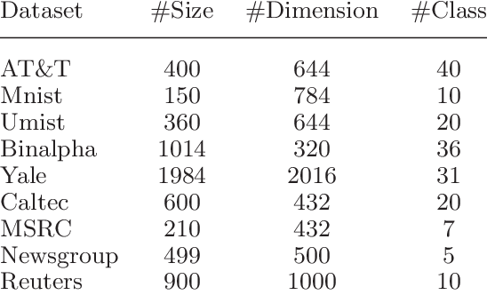
Dataset Description
The dataset consists of information about employees within an organization. It includes various attributes that provide insights into employee demographics, performance, compensation, and tenure. This data is crucial for analyzing workforce distribution, performance metrics, and compensation trends.
Employee ID
Description: A unique identifier assigned to each employee.
Type: Numeric or alphanumeric.
Usage: Used for identifying and referencing individual employees.
Name
Description: Full name of the employee.
Type: Text.
Usage: Personal identification and record-keeping.

Slide 9

THE "WOW" IN OUR SOLUTION
Innovative Data Visualizations:
Interactive Dashboards: Design highly interactive dashboards using Excel features such as slicers, pivot charts, and dynamic ranges. These allow users to filter data on-the-fly and explore various aspects of the workforce, such as departmental performance or compensation trends.
Custom Visuals: Incorporate advanced chart types, like heat maps to visualize performance distribution or waterfall charts to illustrate changes in employee metrics over time. These visuals make complex data more comprehensible and engaging.
Enhanced Decision-Making:
Informed Strategy: Enable more informed decision-making by providing comprehensive, accurate, and easily interpretable data insights, allowing managers and executives to make strategic choices based on solid evidence.
Cost-Effectiveness:
Affordable Excellence: Deliver high-quality analytics and visualizations using Excel, which is a cost-effective alternative to more expensive HR analytics tools, offering significant value without a large financial investment.

Slide 10

MODELLING
Modelling in the context of employee data analysis involves creating structured frameworks within Excel to interpret, analyze, and predict employee-related metrics. This often includes statistical, financial, or predictive models that help in making informed decisions based on historical data.
Data Preparation
1.1 Import and Clean Data:
Import Data: Use Excel’s data import tools (e.g., Power Query) to bring data from different sources (HR systems, payroll, etc.).
Clean Data: Address missing values, remove duplicates, and correct inconsistencies. Ensure that data types are correctly formatted (e.g., dates, numbers).
Data Validation:
Set Validation Rules: Apply data validation rules to ensure data accuracy (e.g., restrict input types, set ranges for numerical values).
Data Structuring:
Organize Data: Arrange data in a tabular format with clear headers and consistent data types.

Slide 11
RESULTS

Slide 12

conclusion
The analysis of employee data conducted using Excel has provided several key insights into our workforce dynamics. Here’s a summary of the most important findings:
Workforce Demographics: The data reveals a diverse employee base with a balanced distribution across various age groups, genders, and educational backgrounds. This diversity contributes to a well-rounded and inclusive work environment.
Employee Satisfaction: Survey results on employee satisfaction suggest that overall morale is high, but there are areas for improvement, particularly concerning work-life balance and career progression opportunities.

